Slide 1
Election Security
Ronald L. Rivest
MIT
Boston University Cyber Alliance
April 4, 2019

Slide 2
Outline
Security Requirements
Evidence-based Elections
Software Independence
Auditing of Paper Ballots
k-cut for sampling
Bayesian audits
Cryptographic Voting Schemes (E2E-V)
Remote (Internet) Voting ???

Slide 3
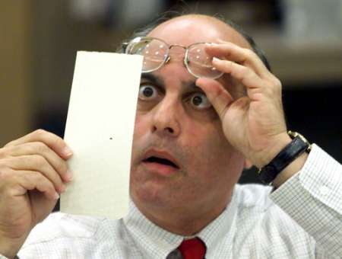
Have we made progress since 2000?
Hanging chads (2000)
Voting Machines at Risk (2015)

Slide 4
Nov. 2016 – Who Really Won?

Slide 5
How do we vote?

Slide 6
Paper Ballots, mostly

Slide 7
1893 – “Australian” Paper Ballot

Slide 9
Stats by number of voters
55% Voter marked paper ballots
13% mixed: paper ballots + DRE w/ VVPAT
5% mixed: paper ballots + DRE w/o VVPAT
6% DRE w/ VVPAT
21% DRE w/o VVPAT
Roughly: 79% use voter-verifiable paper! (stats from Verified Voting)

Slide 10
Optical scanners are used for efficient tabulation

Slide 11
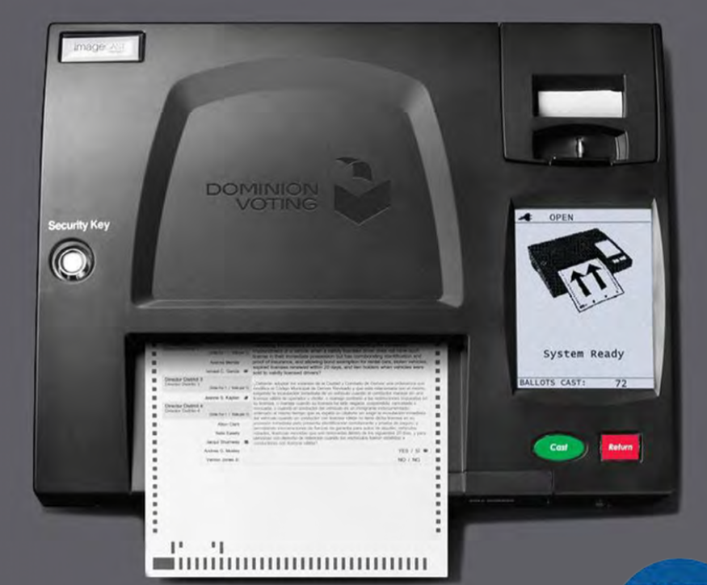

Slide 12
(Concern:) Scanners may introduce systematic errors

Slide 13
Causes of scanner errors
Differences in interpretation between machine interpretation, and hand interpretation based on “voter intent” rules.
Stray marks (e.g. caused by folds)
Configuration errors
Programming errors
Hacking (adversarial attack)

Slide 14
How should we vote?

Slide 15
Security Requirements

Slide 16
Security Requirements
Only eligible voters may vote, and each eligible voter votes at most once.
Each cast vote is secret, even if voter wishes otherwise! -- No vote-selling! -- No receipt showing how you voted!
Final outcome is verifiably correct.
No ``trusted parties’’ – all are suspect! Vendors, voters, election officials, candidates, spouses, other nation-states, …

Slide 17
Evidence-Based Elections
An election system should not only
accurately figure out who won,
but should also
provide convincing evidence
that the winner really won.
(Stark & Wagner 2012)

Slide 18
Software Independence
(Rivest & Wack, 2006)

Slide 19
And Who Do You Hope You Voted For?

Slide 20
Software Independence
Software is not to be trusted!
A voting system is software independent if an undetected error in the software can not cause an undetectable change in the election outcome.
Strongly software-independent if it is possible to correct any such outcome error
Example: Paper ballots (with hand recount)

Slide 21
NASEM Report (9/6/19)
National Academies issued report on ”Securing the Vote”
www.nap.edu/futureofvoting
(159 pages; free pdf)
41 recommendations

Slide 22
Recommendation 4.12 Use voter verifiable paper ballots everywhere by 2020

Slide 23
Recommendations 5.7—5.9 Audit election outcomes!

Slide 24
Recommendations 5.7—5.9 Audit election outcomes!
A risk-limiting audit (RLA) uses manual interpretation of randomly chosen cast paper ballots to verify with high probability the reported election outcome (or correct it, if wrong).

Slide 25
Election Process (paper ballots)
Print ballots; setup
Mark Choices; Verify Vote; Cast Vote!
Optical scanners give initial (“reported”) outcome
Statistical audit of cast paper ballots by hand to confirm/disprove reported outcome
“Brush your teeth; eat your spinach; audit your elections!” -- Poorvi Vora

Slide 26
Auditing of Paper Ballots

Slide 27
Audits are about:
Sampling cast paper ballots at random
Counting, or Sampling with k-cut
Figuring out what the sampled ballots tell you about the reported election results
Risk-Limiting audits, or Bayesian audits

Slide 28
Who is audit for?
Losing candidates – to convince them that “they lost fair and square”
The winner – to provide a mandate
The public – to assuage doubts about “rigged elections”
Election officials – to help them provide accurate and efficiently-verified results

Slide 29
General audit structure
Cast Votes
Sample
Draw an initial random sample of ballots.
Interpret them by hand.
Stop if reported outcome is now confirmed to desired confidence level.
If all ballots have now been examined, you have done a full recount, and are done. Otherwise increase sample size; return to 2.

Slide 30
What a RLA does not do
A RLA does not address:
correctness of the tally (as opposed to the outcome)
voter eligibility
voter authentication
usability
privacy
chain of custody of paper ballots

Slide 31
Two auditing paradigms
Ballot-polling audits: Uses the cast paper ballots only. Like ``exit poll’’ of ballots…
Comparison audits: Compares paper ballot with corresponding electronic records (``cast vote records’’ – CVRs)
Comparison audit more efficient by a factor of roughly (1 / margin-of-victory).

Slide 32
Bravo audit [LSY12]
Ballot-polling audit
Risk-limiting audit: provides guarantee that chance of accepting incorrect outcome is at most given risk limit (e.g. α = 0.05).
Uses reported margin-of-victory as input.
Accumulates product over sampled votes for Alice or Bob of 2A or 2B where A, B are reported fractions of votes for Alice, Bob, stopping when product exceeds 1 / α .

Slide 33
Sampling with k-cut

Slide 34
Finding a random ballot
Counting is standard method: count down to desired ballot
k-cut is new method (Mayuri Sridhar & Rivest ‘18)
Perform k = 6 “cuts” (each moving some top portion to bottom)

Slide 35
Counting
Please count to ballot 572 out of these 901 !

Slide 36
k-cut
Get random number hint H between 1 and 99 (google “random number generator” for app)
Cut (take) approximately H % of ballots off top and move to bottom. OK to “eye-ball” it.
Repeat above k = 6 times.
Take top ballot as randomly selected ballot.

Slide 37
k-cut video

Slide 38
Remarks on k-cut
Can be about 5X faster (depending…)
May decrease risk limit a tad to account for residual non-uniformity of sampling
Analysis: Markov chain convergence
k-cut does not work for ballot-comparison audits where you are looking for ballot with specific ID.
For details, see: https://arxiv.org/abs/1811.08811

Slide 39
Auditing other outcome rules

Slide 40
Social choice functions
Not all elections are plurality
Some elections are ranked-choice: ballot gives voter’s preferences: A > C > D > B
A specified ``social choice function’’ maps collections of ballots to outcomes.
Example: IRV (Instant Runoff Voting) – Keep eliminating candidate with fewest first-choice votes until some candidate has a majority of first-choice votes. (ME, San Francisco use IRV.)

Slide 41
Black-box audits
“Black-box audits” only need to
draw random samples
derive many variant collections from a random sample
apply the social choice function in a “black-box” manner to those variant collections, to determine the winners of those collections.
Black-box audits thus apply to any voting system (any social choice function) !
Example: Bayesian audits.

Slide 42
Bayesian audits

Slide 43
Audit Rochester Hills MI (12/3/2018)
Reported results for Proposition: 22,999 Yes 12,343 No 1,324 Other
Sample results for Proposition: 50 Yes 26 No 0 Other
So… ???

Slide 44
Compare RLA with Bayesian
RLA Question: What is current ``risk’’? (Probability that if reported winner is incorrect, audit would nonetheless accept it if audit stopped now.)
Bayesian Question: What is probability that reported winner would lose if all ballots were examined? (“upset probability”)

Slide 45
Bayesian Method (ballot polling)
Start by drawing sample of paper ballots from population of cast paper ballots.
Extend for remaining ballots, but simulating what you might see: replace each draw of a paper ballot with copy of random earlier ballot.
Find winner for all (drawn and simulated) ballots.
Repeat steps 2—3 many times, measuring fraction of time reported winner loses.
Repeat with larger sample if fraction > 5%.

Slide 46
Figure
Sample (76)
Extension (36590)
Y Y N Y Y Y … Y N
Each new element of extension is copy of random ballot to its left.

Slide 47
Figure
Sample (76)
Extension (36590)
Y Y N Y Y Y … Y N N
Each new element of extension is copy of random ballot to its left.

Slide 48
Figure
Sample (76)
Extension (36590)
Y Y N Y Y Y … Y N N Y
Each new element of extension is copy of random ballot to its left.

Slide 49
Figure
Sample (76)
Extension (36590)
Y Y N Y Y Y … Y N N Y N
Each new element of extension is copy of random ballot to its left.

Slide 50
Figure
Sample (76)
Extension (36590)
Y Y N Y Y Y … Y N N Y N … … … … N Y
Each new element of extension is copy of random ballot to its left.

Slide 51
Results
RLA results:
Risk measured at 2.1 %
(Kellie Ottoboni using SUITE tool)
Bayesian results: 99.7 % of time Yes wins 0.3 % of time No wins (Mayuri Sridhar using BPTOOL)
Both methods confirm reported outcome.

Slide 52
Remarks
Bayesian methods extend to:
Ballot-comparison audits
Hybrid audits (CVR and no-CVR strata)
IRV or other complex voting schemes
For more details see https://arxiv.org/abs/1801.00528

Slide 53
End-to-end Verifiable Voting

Slide 54
End-to-End Verifiable Voting
Provides “end-to-end” integrity; votes are
“cast as intended” (verified by voter)
“collected as cast” (verified by voter or proxy)
“counted as collected” (verified by anyone)
Paper ballots have only first property; once ballot is cast, integrity depends on “chain of custody” of ballots.
End-to-end systems provide software independence, verifiable chain of custody, and verifiable tally.

Slide 55
Public Bulletin Board (PBB)
Public Bulletin Board:
Election parameters Voter, E(Vote) pairs:
“Abe”, E(vote_{Abe})
“Ben”, E(vote_{Ben})
…
Reported winner
Proof of correctness
E2E systems have append-only “public bulletin board” posting election information, including encryptions of votes.
PBB posts “evidence” (proof) that reported winner is correct.
Use blockchain ??

Slide 56
Votes are encrypted
She can verify that encryption was done correctly using cute “cast or challenge” protocol due to Josh Benaloh…
Voter gets “receipt”: copy of her encrypted vote (same as what is posted on PBB)
Voter can’t use receipt to sell her vote!

Slide 57
Voter can confirm chain of custody
Voter names and receipts posted on PBB
Voter checks “collected as cast” by verifying that her name/receipt is posted on PBB
If it is missing, she can credibly complain if her receipt is ``authentic’’ (e.g. hard to forge).
Enough credible complaints ➔ Re-run election!

Slide 58
Anyone can verify tally
PBB posts final tally (reported outcome) and crypto proof that reported outcome is correct.
Use homomorphic tallying: E(v1) E(v2) = E(v1+v2) Product of ciphertexts is ciphertext of sum.
Decrypting individual ballots not necessary; only product of all votes gets decrypted.
Election authorities post proof that decryption of product is correct.

Slide 59
E2E deployments in real elections
Scantegrity (Chaum; Takoma Park, MD; 2009 & 2011)
Wombat (Rosen; 3 elections in Israel; 2011 & 2012)
Prêt à Voter (Ryan; New South Wales, Australia; 2014)
StarVote (Austin, Texas) (DeBeauvoir; (was) in progress…)

Slide 60
Best of both worlds: paper + electronic E2E
Some hybrid systems, like Scantegrity, Wombat, and StarVote, have both: a paper ballot and an electronic E2E subsystem.
Can statistically audit paper ballots as usual, and can audit electronic records on PBB as usual for E2E system.

Slide 61
Recommendation 5.11 No Internet voting!

Slide 62
When can I vote on the Internet? (or on my phone?)
http://voteinyourpajamas.org/

Slide 63
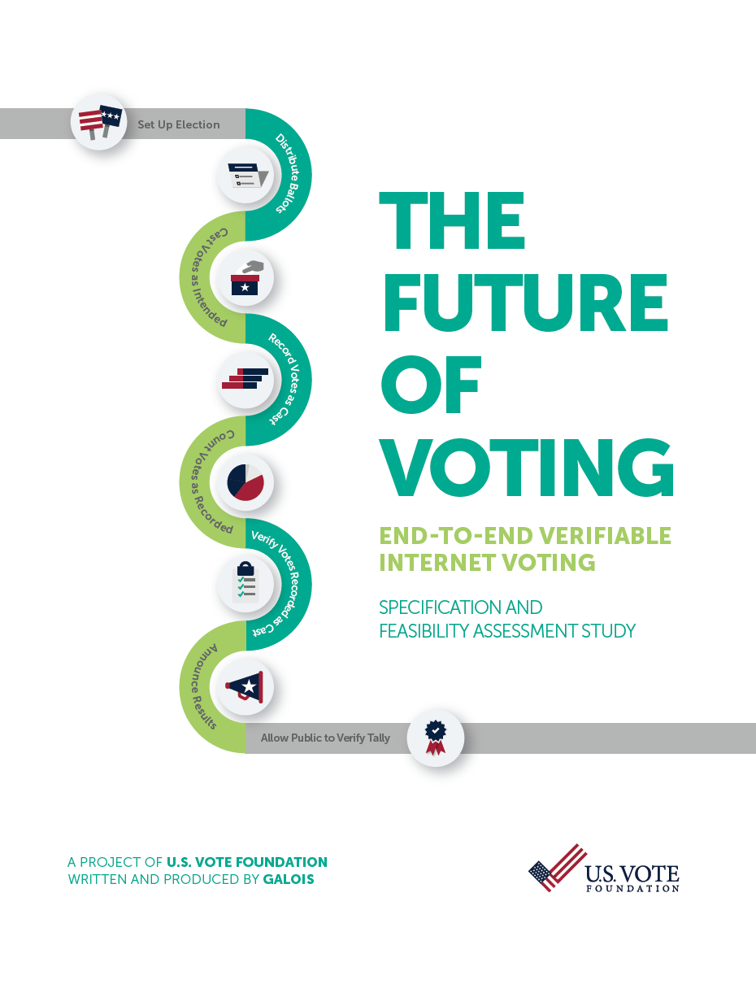
U.S. Vote Foundation 2015 Report on Internet Voting:
E2E necessary for IV
But: E2E should first be well-established and understood for in-person voting, and
E2E not sufficient for IV: many problems remain:
Malware
DDOS attacks
Authentication
MITM attacks
Zero-day attacks on servers
Coercion & vote-selling
…

Slide 64
Conclusions
We can make elections much more secure with post-election audits and cryptography.
End-to-end verifiable voting methods are the way to go, long-term.
Especially hybrid methods with paper+E2E
We’re not yet ready for ``internet voting,’’ and may not be for 20 years…

Slide 65
The End
Thanks for your attention!
(and thanks to NSF CSOI and to Verified Voting!)

