Slide 1

Sources of Instability in Data Center Multicast
Dmitry Basin
Ken Birman
Idit Keidar
Ymir Vigfusson

Slide 2
Multicast is Important
Replication is used in data centers and clouds:
  to provision financial servers of read-mostly requests
  to parallelize computation
  to cache important data
  for fault-tolerance
Reliable multicast is a basis for consistent replication
  Transactions that update replicated data
  Atomic broadcast

Slide 3
Why not IP/UDP-based Multicast ?
CTOs say these mechanisms may destabilize the whole data center
  Lack of flow control
  Tend to cause “synchronization”
    Load oscillations
Anecdotes (eBay, Amazon):
  All goes well until one day, under heavy load, loss rates spike, triggering throughput collapse

Slide 4
TCP Tree Overlays
Most common variant of data center multicast
    The cost of a cloud: research problems in data center networks. Greenberg, Hamilton, Maltz, and Patel.
    Toward a cloud computing research agenda. Birman, Chockler, and van Renesse.
Most application level multicast protocols use trees implicitly
  SCRIBE, NICE. Mesh-solutions also, as long as no node failures
  The time without failures in DC can be long
Advantages:
  Flow and congestion control
  Should be stable ..?
TCP
TCP
TCP
TCP
TCP
TCP
TCP
TCP
TCP
TCP
TCP
TCP
TCP
TCP

Slide 5
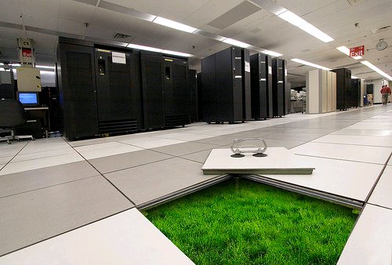


Suppose We Had a Perfect Tree
Suppose we had a perfect multicast tree:
  High throughput - low latency links
  Very rare node failures
Would it work fine?
Would the multicast have high throughput?
  Theory / simulations papers say: YES!
    [Baccelli, Chaintreau, Liu, Riabov. 2005]
  Data center operators say: NO!
    Observed throughput collapse and oscillations when the system became large
Notes:
Check year, add more references,

Slide 6

Our Goal: Explain the GAP
Our hypothesis: instability stems from disturbances
  Very rare, short events
    OS scheduling, network congestion, Java GC stalls, …
    Never modeled or simulated before
  Become significant when system grows
What if there were one pea per mattress?

Slide 7
Multicast Model
Complete tree

Slide 8
Multicast Model
Reliable links with congestion and flow control (e.g. TCP links)

Slide 9
Multicast Model
Incoming buffers
of size B₀
Outgoing buffers
of size B₀

Slide 10
Multicast Model
Thread forwards packets from incoming to outgoing buffers
3
2
2
1

Slide 11
Multicast Model
Application
1
2
1
Root forwards packets from application to outgoing buffers

Slide 12
Multicast Model
Application
3
If any outgoing buffer is full, thread stalls
Ok
Oops..
2
2
1

Slide 13
Analytic Model: Node States
Node’s thread is stuck
State duration has distribution with finite expectation
Pr(Good) =
Good
Bad
Pr(Bad) =
Node’s thread works properly
Memoryless process: duration has exponential distribution with expectation
Notes:
Stuck instead of stalled ?

Slide 14
Analytic Model: System States
some node u becomes Bad
Active
Blocking
node u becomes Good

Slide 15
Application
Active
3
B_{max} - aggregate buffer size from the root to a leaf
3
A
2
2
1
1
B
C
D
E
F
G
Application
Application
Application
Application
Notes:
Add text to animations (clouds)

Slide 16
some node B becomes Bad
Application
Active
Blocking
4
4
A
Node B becomes Bad.
Thread does not forward packets
3
3
2
2
1
1
1
B
B
C
D
E
F
G
Application
Application
Application
Application
Notes:
B disapp

Slide 17
Application
Blocking
4
4
Root can fill buffers on the path to B before blocking
A
3
3
2
2
1
1
1
B
C
D
E
F
G
Application
Application
Application
Application
Notes:
Swap the colors
Explanation of blocking

Slide 18
Application
Blocking
A
Link flow control prevents further sending
4
4
3
3
2
1
2
2
B
C
1
1
D
E
F
G
Application
Application
Application
Application

Slide 19
Application
Blocking
5
The thread can’t forward. The root blocks.
A
4
3
4
2
1
3
3
B
C
2
2
1
1
D
E
F
G
Application
Application
Application
Application

Slide 20
Application
Blocking
5
A
The system state remains Blocking
4
3
2
1
4
4
B
C
3
3
Node G becomes Bad
2
2
D
E
F
G
G
Application
Application
Application
Application

Slide 21
Application
Active
Blocking
5
node B becomes Good
During Blocking state:
# sent bits ≤ buffers on path to B ≤ B_{max}
A
Node B becomes Good
4
3
2
1
B
B
C
4
4
3
3
D
E
F
G
Application
Application
Application
Application

Slide 22
Application
Active
5
A
4
3
2
1
1
B
C
4
4
3
D
E
F
G
Application
Application
Application
Application

Slide 23
Application
Active
5
The root unblocks
A
4
Can send again
3
2
2
B
C
1
1
4
3
D
E
F
G
Application
Application
Application
Application

Slide 24
some node E becomes Bad
Application
Active
Blocking
5
6
5
A
4
3
3
B
C
Node E becomes Bad
2
2
4
1
1
3
D
E
E
F
G
Application
Application
Application
Application

Slide 25
Analysis
Period: Active and successive Blocking state
The aggregate throughput during m periods is:
  data root sent in Active state in period k (bits)
  data root sent in Blocking state in period k (bits)
  duration of Active state in period k (sec)
  duration of Blocking state in period k (sec)
Notes:
Add total time , total amount of data

Slide 26
Analysis: Throughput in Each State
Blocking state:
  Best-case assumption (for upper bound)
    At the beginning buffers are empty
    B_{k} is bounded by B_{max}
  Long-term average of t_{Bk} is

Slide 27
Analysis: Throughput in Each State
Active state:
  Best-case assumption (for upper bound)
    Root always sends at maximal throughput
    Flow control is perfect – no slow start
  State duration (t_{Ak}) analysis is complex (see paper)

Slide 28
Analysis: Throughput Bound
We prove a bound on AGGR(m)
Duration of Good state
Throughput bound
Duration of Good state
Notes:
Explain the formula (put a graph) or remove it

Slide 29
Analysis: Throughput Bound
We prove a bound on AGGR(m)
Duration of Bad state
Throughput bound
Duration of Bad state

Slide 30
Analysis: Throughput Bound
System size
We prove a bound on AGGR(m)
Throughput bound
System size
Notes:
Explain the formula (put a graph) or remove it

Slide 31
Simulations
Remove the assumption of empty buffers
  Use real buffers
  At nodes close to the root, measured to be full half the time
Still assume perfect flow control
  No slow start
  Hence still upper bound on real network
Our simulations
  Big trees (10,000s of nodes)
  Small trees (10s of nodes)

Slide 32
Use Case 1: Big Trees
Tree spanning an entire data center
  10,000s of nodes
Used for control

Slide 33
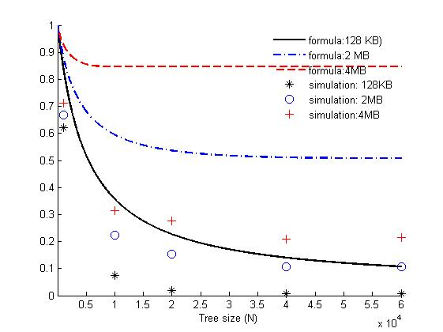
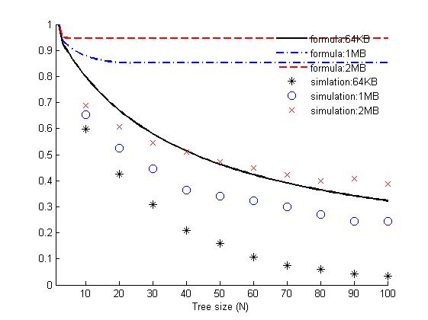

Results: Aggregate Throughput Bound
Analytic bound not so pessimistic
when buffers are large
Disturbances every hour for 1 sec
Simulations show we still have a problem
(because buffers are full half the time)
Analytic bound: TCP default buffers (64KB), 10K nodes
~65% degradation
Simulations much worse: ~90% degradation
Notes:
When system grows – throughput degrades.
Replace top callouts:
- Analytic bound not so pessimistic when buffers are large
(because we assume buffers to be empty upon blocking)
- Simulations show we still have a problem (because buffers are full half the time)

Slide 34
Use Case 2: Small Trees

Slide 35
Average Node in DC
Has many different applications using network:
  50% of the time - more than 10 concurrent flows
  5% of the time - more than 80 concurrent flows
    [Greenberg, Hamilton, Jain, Kandula, Kim, Lahiri, Maltz, Patel, Sengupta, 2009]
Can’t use too big buffers
Switch port might congest

Slide 36
TCP Time-Outs as Disturbances
Temporary switch congestion can cause a loss burst on a TCP link
The following TCP link time-out can be modeled as a disturbance
Default TCP implementations
  Min. time-out 200 ms
  Network RTT can be ~200us
  The source of well-known Incast problem
    [Nagle, Serenyi, Matthews 2004]

Slide 37
Results: Aggregate Throughput Bound
Analytical bound: again optimistic for larger buffers
Time-outs every 5 sec for 200 msec
Simulations: again bigger buffers help only in theory
Analytic bound: TCP default buffers (64KB), 50 nodes
Simulations much worse
Notes:
Text for callout:
- Throughput upper bound drops to 50% with as few as 50 nodes
- Simulations much worse – only 20% for 50 nodes
Again, bigger buffers help only in theory

Slide 38
Conclusions
We explain why supposedly perfect tree-based multicast inevitably collapses in data centers:
  Rare and short disruption events (disturbances) can cause throughput collapse when system grows
  Frequent disturbances can cause throughput collapse even for small system sizes
Reality is even worse than our analytic bound:
  Disturbances cause buffers to fill up
  The main reason of the gap between simulation and analysis

Slide 39
Thank you.

