Slide 2
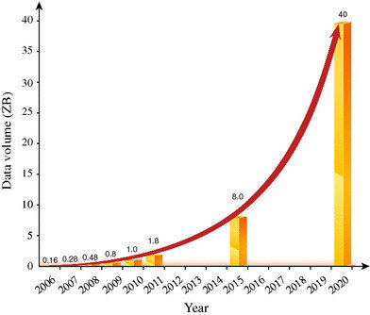

Slide 3
“Data is the oil of the new age”

Slide 4
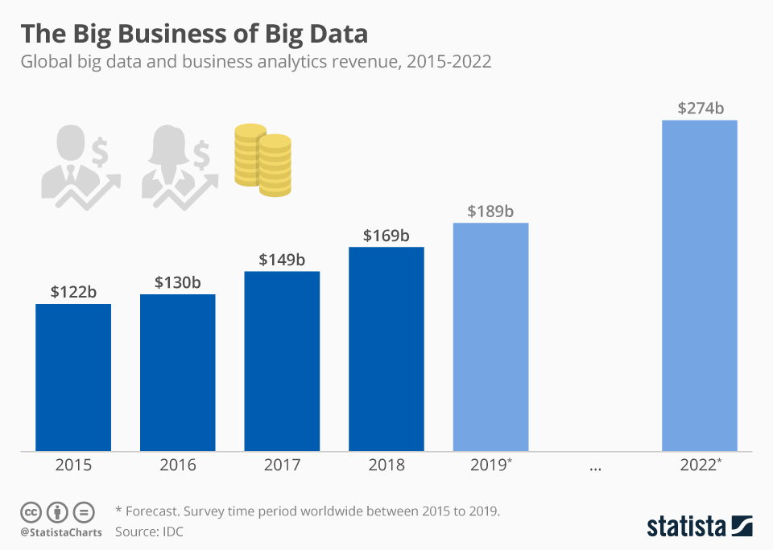
“Data is the oil of the new age”

Slide 5
“Data is the oil of the new age”
but, just like oil,
“unrefined data cannot really be used”

Slide 6
“Data is the oil of the new age”
but, just like oil,
“unrefined data cannot really be used”
How do we refine data?

Slide 9
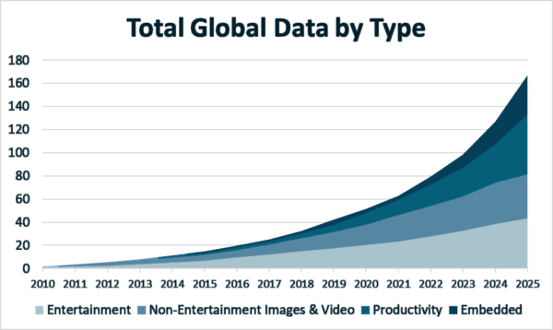

Slide 10
MapReduce [Dean, Ghemawat, ‘04, ‘08]
Hadoop [White, ‘12]
Pregel [Google, ‘09]
Dryad [Isard, Budiu, Yu, Birrell, Fetterly, ‘07]
Spark [Zaharia, Chowdhury, Franklin, Shenker, Stoica, ‘10]
Flume [Chambers, Raniwala, Perry, Adams, Henry, Bradshaw, Weizenbaum, ‘10]
…

Slide 11
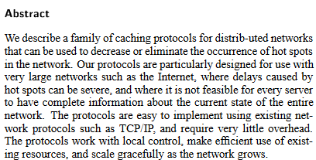

Slide 15
Parallel Random Walks

Slide 16
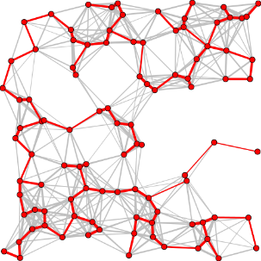
Why Random Walks?
Web ratings [Page, Brin, Motwani, Winograd ’99] [Berkhin ‘05]
[Chierichetti, Haddadan ‘17]
Graph partitioning [Andersen, Chung, Lang ‘06]
Random spanning trees [Kelner, Mądry ‘09]
Laplacian solvers [Andoni, Krauthgamer, Pogrow ‘18]
Connectivity [Reif ’85] [Halperin, Zwick ’94]
Matching [Goel, Kapralov, Khanna ‘13]
Property testing [Goldreich, Ron ’99] [Kaufman, Krivelevich, Ron ‘04]
[Czumaj, Sohler ’10] [Nachmias, Shapira ‘10] [Kale, Seshadhri ‘11]
[Czumaj, Peng, Sohler ’15] [Chiplunkar, Kapralov, Khanna, Mousavifar, Peres ‘18]
[Kumar, Seshadhri, Stolman ‘18] [Czumaj, Monemizadeh, Onak, Sohler ’19]

Slide 17
How to Compute Random Walks?

Slide 18
How to Compute Random Walks?
(in “a small” number of parallel steps)

Slide 19
Massively Parallel Computation (MPC)
All-to-all synchronous communication
S
S
S
S
N machines:
. . .
N * S = O(#edges)

Slide 20
Massively Parallel Computation (MPC)
All-to-all synchronous communication
S
S
S
S
N machines:
. . .
N * S = O(#edges)
S
S
S
S
. . .

Slide 21
Massively Parallel Computation (MPC)
All-to-all synchronous communication
S
S
S
S
N machines:
. . .
N * S = O(#edges)
Local running
time can be
arbitrarily large.
S
S
S
S
. . .

Slide 22
Massively Parallel Computation (MPC)
All-to-all synchronous communication
Models computation
in datacenters.
S
S
S
S
N machines:
. . .
N * S = O(#edges)
Local running
time can be
arbitrarily large.
S
S
S
S
. . .

Slide 23
A simple approach
v

Slide 24
A simple approach
v

Slide 25
A simple approach
v

Slide 26
A simple approach
v

Slide 27
A simple approach
Takes O(L) rounds.
Can we do faster?
v

Slide 28
Idea: Predict where random-walk prefixes will end
and prepare their continuation (stitch them).

Slide 29
Idea: Predict where random-walk prefixes will end
and prepare their continuation (stitch them).
Challenge: How can we predict the future?

Slide 30
Prior work (length-L random walks)
Random walks [Sarma, Molla, Pandurangan and Upfal ‘12]:
undirected: O(√L) rounds
directed: O(L) rounds
PageRank [Haveliwala and Kamvar ’03]:
directed: O(log n / ε) rounds, Power method

Slide 31
Prior work (length-L random walks)
Random walks [Sarma, Molla, Pandurangan and Upfal ‘12]:
undirected: O(√L) rounds
directed: O(L) rounds
PageRank [Haveliwala and Kamvar ’03]:
directed: O(log n / ε) rounds, Power method
Our results in MPC
(multiple independent walks)
Random walks:
undirected: O(log L) rounds
directed: O(log² L + log² log n) rounds
PageRank:
directed: O(log² 1/ε + log² log n) rounds
Space per machine: sublinear in n
Total space: O(m^{1+o(1)} L).

Slide 32
Prior work (length-L random walks)
Random walks [Sarma, Molla, Pandurangan and Upfal ‘12]:
undirected: O(√L) rounds
directed: O(L) rounds
PageRank [Haveliwala and Kamvar ’03]:
directed: O(log n / ε) rounds, Power method
Our results in MPC
(multiple independent walks)
Random walks [Bahmani, Chakrabarti and Xin ‘11]:
directed and dependent: O(log L) rounds
Random walks:
undirected: O(log L) rounds
directed: O(log² L + log² log n) rounds
PageRank:
directed: O(log² 1/ε + log² log n) rounds
Space per machine: sublinear in n
Total space: O(m^{1+o(1)} L).

Slide 33
(undirected)
Random walks
Part I

Slide 34
(undirected)
Random walks
Part I
PageRank
Part II
(directed)

Slide 35
(undirected)
Random walks
Part I
(directed)
Part III
PageRank
Part II
(directed)

Slide 36
Part I: Random Walks in Undirected Graphs

Slide 37
Idea: Stitching
v
L

Slide 38
Idea: Stitching
v
L
1. Instead, each vertex samples L/2-length walk
w
v
L/2
L/2
w
x

Slide 39
Idea: Stitching
v
L
1. Instead, each vertex samples L/2-length walk
w
v
L/2
L/2
w
x
2. Stitch
L
x
v

Slide 40
Idea: Stitching
L
Recurse for lengths L/2, L/4, …
v
1. Instead, each vertex samples L/2-length walk
w
v
L/2
L/2
w
x
2. Stitch
L
x
v

Slide 41
Idea: Stitching
L
Recurse for lengths L/2, L/4, …
v
1. Instead, each vertex samples L/2-length walk
w
v
L/2
L/2
But how w knows a priori how many walks will pass through it?
w
x
2. Stitch
L
x
v

Slide 42
Follow π
Stationary distribution:
π W = π

Slide 43
Example: Stationary distribution
5
π W = π
2
3
4
1

Slide 44
Example: Stationary distribution
5
π W = π
2
3
4
1

Slide 45
Example: Stationary distribution
5
π W = π
0 | 1/3 | 1/3 | 1/3 | 0
1 | 0 | 0 | 0 | 0
1/2 | 0 | 0 | 0 | 1/2
1/2 | 0 | 0 | 0 | 1/2
0 | 0 | 1/2 | 1/2 | 0
2
3
4
W =
1

Slide 46
Example: Stationary distribution
5
π W = π
π(v) = d(v) / (2m)
0 | 1/3 | 1/3 | 1/3 | 0
1 | 0 | 0 | 0 | 0
1/2 | 0 | 0 | 0 | 1/2
1/2 | 0 | 0 | 0 | 1/2
0 | 0 | 1/2 | 1/2 | 0
2
3
4
W =
1
π = (3/10, 1/10, 2/10, 2/10, 2/10)

Slide 47
Follow π
G
Vertex v computes proportionally to π(v) , say d(v), many random walks.
w
v
y

Slide 48
Follow π
G
Vertex v computes proportionally to π(v) , say d(v), many random walks.
w
In expectation, after t steps there are proportionally to π(v) walks ending at v.
v
y

Slide 49
Takeaway
1. Following π allows us to “predict” the future.

Slide 50
Takeaway
1. Following π allows us to “predict” the future.
≥1/(2m)
2. The memory requirement is inversely proportional to the min entry of π.

Slide 51
Sooo, what’s the trouble with directed?
Undirected graphs
Directed graphs
vs

Slide 52
Sooo, what’s the trouble with directed?
Undirected graphs
Directed graphs
π is easy to compute:
π(v)=deg(v) / (2m).
vs
π(v) is “nicely” lower-bounded.

Slide 53
Sooo, what’s the trouble with directed?
Undirected graphs
Directed graphs
π is easy to compute:
π(v)=deg(v) / (2m).
π can be difficult to compute.
vs
π(v) is “nicely” lower-bounded.

Slide 54
Sooo, what’s the trouble with directed?
Undirected graphs
Directed graphs
π is easy to compute:
π(v)=deg(v) / (2m).
π can be difficult to compute.
vs
π(v) is “nicely” lower-bounded.
π(v) can be O(1/2^{n}).

Slide 55
Part II: PageRank in Directed Graphs

Slide 56
Knowing π ≈ knowing the future

Slide 57
PageRank (directed)
Input: $P=GD^{−1}$
$$T=\left(1−ε\right)P+\frac{ε}{n}\vec{1}{\vec{1}}^{T}$$
Output: π of $T$

Slide 58
PageRank (directed)
Input: $P=GD^{−1}$
$$T=\left(1−ε\right)P+\frac{ε}{n}\vec{1}{\vec{1}}^{T}$$
Walk matrix of G.
(D is a diagonal
degree matrix)
Output: π of $T$
Jumping to a random vertex
Following P with prob. $1−ε$.

Slide 59
PageRank (directed)
Input: $P=GD^{−1}$
$$T=\left(1−ε\right)P+\frac{ε}{n}\vec{1}{\vec{1}}^{T}$$
Output: π of $T$
Random walks
PageRank
π difficult to compute.
vs
π(v) can be O(1/2^{n}).

Slide 60
PageRank (directed)
Input: $P=GD^{−1}$
$$T=\left(1−ε\right)P+\frac{ε}{n}\vec{1}{\vec{1}}^{T}$$
Output: π of $T$
Random walks
PageRank
π difficult to compute.
We do not know π of $T$.
vs
π(v) can be O(1/2^{n}).

Slide 61
PageRank (directed)
Input: $P=GD^{−1}$
$$T=\left(1−ε\right)P+\frac{ε}{n}\vec{1}{\vec{1}}^{T}$$
Output: π of $T$
Random walks
PageRank
π difficult to compute.
We do not know π of $T$.
vs
π(v) can be O(1/2^{n}).
π(v) w.r.t. $T$ at least ε/n.

Slide 62
PageRank (directed)
Input: $P=GD^{−1}$
$$T=\left(1−ε\right)P+\frac{ε}{n}\vec{1}{\vec{1}}^{T}$$
Enables us to use
stitching idea
Output: π of $T$
Random walks
PageRank
π difficult to compute.
We do not know π of $T$.
vs
π(v) can be O(1/2^{n}).
π(v) w.r.t. $T$ at least ε/n.

Slide 63
How to compute PageRank?
[Breyer ‘02]
PageRank can be approximated by running O(log n) random walks of length O(log n/$ε$) from each vertex.

Slide 64
How to compute PageRank?
[Breyer ‘02]
PageRank can be approximated by running O(log n) random walks of length O(log n/$ε$) from each vertex.
Approximating PageRank “equals” computing O(log n) short random walks from each vertex.

Slide 65
How to compute PageRank?
[Breyer ‘02]
PageRank can be approximated by running O(log n) random walks of length O(log n/$ε$) from each vertex.
Undirected PageRank simple
Approximating PageRank “equals” computing O(log n) short random walks from each vertex.

Slide 66
How to compute PageRank?
[Breyer ‘02]
PageRank can be approximated by running O(log n) random walks of length O(log n/$ε$) from each vertex.
Undirected PageRank simple
Approximating PageRank “equals” computing O(log n) short random walks from each vertex.
How about directed PageRank?

Slide 67
Molding Undirected to Directed

Slide 68
Molding Undirected to Directed
PageRank G^{U}
PageRank G^{D}

Slide 69
Molding Undirected to Directed
$$G_{j}=\left(1 −\frac{j}{\log{\log{n} }}\right)G^{U}+\frac{j}{\log{\log{n}}}G^{D}$$
$$G_{0}=G^{U}$$
$$G_{\log{\log{n}}}=G^{D}$$
PageRank G^{U}
PageRank G^{D}

Slide 70
Molding Undirected to Directed
$$G_{j}=\left(1 −\frac{j}{\log{\log{n} }}\right)G^{U}+\frac{j}{\log{\log{n}}}G^{D}$$
$$G_{0}=G^{U}$$
$$G_{\log{\log{n}}}=G^{D}$$
$$G^{U}$$
$$G^{U}$$
$$G^{U}$$
$$G^{D}$$
$$G^{U}$$
PageRank G^{U}
PageRank G^{D}

Slide 71
Molding Undirected to Directed
$$G_{j}=\left(1 −\frac{j}{\log{\log{n} }}\right)G^{U}+\frac{j}{\log{\log{n}}}G^{D}$$
Random walks
for G₁.
PageRank G^{U}
PageRank G^{D}

Slide 72
Molding Undirected to Directed
$$G_{j}=\left(1 −\frac{j}{\log{\log{n} }}\right)G^{U}+\frac{j}{\log{\log{n}}}G^{D}$$
PageRank approximated from short random walks [Breyer ‘02]
Random walks
for G₁.
PageRank G^{U}
PageRank G₁
PageRank G^{D}

Slide 73
Molding Undirected to Directed
$$G_{j}=\left(1 −\frac{j}{\log{\log{n} }}\right)G^{U}+\frac{j}{\log{\log{n}}}G^{D}$$
PageRank approximated from short random walks [Breyer ‘02]
Random walks
for G₂.
PageRank G^{U}
PageRank G₁
PageRank G₂
PageRank G^{D}

Slide 74
Molding Undirected to Directed
$$G_{j}=\left(1 −\frac{j}{\log{\log{n} }}\right)G^{U}+\frac{j}{\log{\log{n}}}G^{D}$$
PageRank G^{U}
PageRank G₁
PageRank G₂
PageRank G^{D}
. . .

Slide 75
Knowing π ≈ knowing the future
Gradually injected directedness

Slide 76
How to get walk for G_{j+1} from G_{j}?

Slide 77
How to get walk for G_{j+1} from G_{j}?
Input: a walk w in G_{j}
Output: a walk in G_{j+1} or “fail”
Perform rejection sampling on each edge of w in G_{j}.
$$G_{j}=\left(1 −\frac{j}{\log{\log{n} }}\right)G^{U}+\frac{j}{\log{\log{n}}}G^{D}$$

Slide 78
How to get walk for G_{j+1} from G_{j}?
Input: a walk w in G_{j}
Output: a walk in G_{j+1} or “fail”
Perform rejection sampling on each edge of w in G_{j}.
$$G_{j}=\left(1 −\frac{j}{\log{\log{n} }}\right)G^{U}+\frac{j}{\log{\log{n}}}G^{D}$$
e ∈ w:
- e is from G^{U} with prob. 1-j/log log n
- o.w., e is from G^{D}

Slide 79
How to get walk for G_{j+1} from G_{j}?
Input: a walk w in G_{j}
Output: a walk in G_{j+1} or “fail”
Perform rejection sampling on each edge of w in G_{j}.
$$G_{j}=\left(1 −\frac{j}{\log{\log{n} }}\right)G^{U}+\frac{j}{\log{\log{n}}}G^{D}$$
e ∈ w:
- e is from G^{U} with prob. 1-j/log log n
- o.w., e is from G^{D}
- If e is sampled from G^{D} accept
- If e is sampled from G^{U}
* prob 1/(j+1) reject
* o.w., accept

Slide 80
How to get walk for G_{j+1} from G_{j}?
Input: a walk w in G_{j}
Output: a walk in G_{j+1} or “fail”
Perform rejection sampling on each edge of w in G_{j}.
$$G_{j}=\left(1 −\frac{j}{\log{\log{n} }}\right)G^{U}+\frac{j}{\log{\log{n}}}G^{D}$$
e ∈ w:
- e is from G^{U} with prob. 1-j/log log n
- o.w., e is from G^{D}
- If e is sampled from G^{D} accept
- If e is sampled from G^{U}
* prob 1/(j+1) reject
* o.w., accept

Slide 81
Success probability: walk from G_{j} to G_{j+1}
An edge is rejected with prob $\frac{1}{j+1}$
A walk is accepted with prob ${\left(1−\frac{1}{j+1}\right)}^{\frac{\log{n}}{ε}}$

Slide 82
Success probability: walk from G_{j} to G_{j+1}
An edge is rejected with prob $\frac{1}{j+1}$
A walk is accepted with prob ${\left(1−\frac{1}{j+1}\right)}^{\frac{\log{n}}{ε}}$
Case $j>\frac{\log{\log{n}}}{2}$: prob $n^{−1/\log{\log{n}}}$ accept

Slide 83
Success probability: walk from G_{j} to G_{j+1}
An edge is rejected with prob $\frac{1}{j+1}$
A walk is accepted with prob ${\left(1−\frac{1}{j+1}\right)}^{\frac{\log{n}}{ε}}$
Case $j>\frac{\log{\log{n}}}{2}$: prob $n^{−1/\log{\log{n}}}$ accept
Case $j=0$: prob $0$ accep

Slide 84
Success probability: walk from G_{j} to G_{j+1}
An edge is rejected with prob $\frac{1}{j+1}$
G₀ does not have a
mixture of G^{U} and G^{D},
it consists of G^{U} alone.
So, how to use G₀
to get a walk in G₁?
A walk is accepted with prob ${\left(1−\frac{1}{j+1}\right)}^{\frac{\log{n}}{ε}}$
Case $j>\frac{\log{\log{n}}}{2}$: prob $n^{−1/\log{\log{n}}}$ accept
Case $j=0$: prob $0$ accep

Slide 85
Idea: Pretend that an edge of G^{U} is in G^{D}

Slide 86
Idea: Pretend that an edge of G^{U} is in G^{D}
Goal: transform a walk from G^{U} to G₁.
$$G_{1}=\left(1 −\frac{1}{\log{\log{n} }}\right)G^{U}+\frac{1}{\log{\log{n}}}G^{D}$$
v

Slide 87
Idea: Pretend that an edge of G^{U} is in G^{D}
Goal: transform a walk from G^{U} to G₁.
$$G_{1}=\left(1 −\frac{1}{\log{\log{n} }}\right)G^{U}+\frac{1}{\log{\log{n}}}G^{D}$$
v
v
. . .
in-deg = n

Slide 88
Idea: Pretend that an edge of G^{U} is in G^{D}
Goal: transform a walk from G^{U} to G₁.
$$G_{1}=\left(1 −\frac{1}{\log{\log{n} }}\right)G^{U}+\frac{1}{\log{\log{n}}}G^{D}$$
out-deg/deg = large
v
v
out-deg/deg = small
. . .
in-deg = n

Slide 89
Transform the graph s.t. out-deg/deg = large

Slide 90
Transformation
a
v
e₁
e_{n}
. . .
in-deg = n

Slide 91
Transformation
a
v
e₁
a
. . .
e₁
e_{n}
v_{log n}
v
e_{n}
. . .
in-deg = n

Slide 92
Transformation
a
v
e₁
n/2 parallel
edges
a
. . .
e₁
e_{n}
v_{log n}
v_{log n - 1}
v
e_{n}
. . .
in-deg = n

Slide 93
Transformation
a
e₁
n/2 parallel
edges
n/4 parallel
edges
v
a
. . .
. . .
e₁
e_{n}
v_{log n}
v_{log n - 1}
v_{log n - 2}
v
e_{n}
in-deg=2
. . .
in-deg = n

Slide 94
Knowing π ≈ knowing the future
Gradually injected directedness
Boost existing directedness
Pretend that an undirected = directed
Transform to a balanced graph

Slide 95
Part III: Random Walks in Directed Graphs

Slide 96
Walks via PageRank
Input: G^{D}, length L
Output: a walk of length L in G^{D}
Return a PageRank walk of length L for ε=1/L.
With constant probability, this walk
does not make any random jump.
So, it is a random walk in G^{D}.

Slide 97
Walks via PageRank
Input: G^{D}, length L
Output: a walk of length L in G^{D}
Return a PageRank walk of length L for ε=1/L.
Oh, we can set ε as small
as we like at no cost?
With constant probability, this walk
does not make any random jump.
So, it is a random walk in G^{D}.

Slide 98
Walks via PageRank
Input: G^{D}, length L
Output: a walk of length L in G^{D}
Return a PageRank walk of length L for ε=1/L.
Oh, we can set ε as small
as we like at no cost?
Reminder
A walk is accepted with
prob ${\left(1−\frac{1}{\log{\log{n}}}\right)}^{\frac{\log{n}}{ε}}$
With constant probability, this walk
does not make any random jump.
So, it is a random walk in G^{D}.

Slide 99
Walks via PageRank
Input: G^{D}, length L
Output: a walk of length L in G^{D}
Return a PageRank walk of length L for ε=1/L.
Oh, we can set ε as small
as we like at no cost?
Reminder
A walk is accepted with
prob ${\left(1−\frac{1}{\log{\log{n}}}\right)}^{\frac{\log{n}}{ε}}$
With constant probability, this walk
does not make any random jump.
So, it is a random walk in G^{D}.
For L > log n, then ε < 1/log n and the acceptance prob. is too low.

Slide 100
Handling small ε
Let ε’ be the target value of ε
Transition from G^{D} for ε=1/2 to G^{D} for ε=ε’.
The transition is done in a similar manner as for going from G₀ to G_{log log n}.

Slide 101
To summarize
Transform the graph so that out-deg/deg ≥ 1/3.
Transition from G^{U} to G^{D} for ε=1/2.
Transition from ε=1/2 to ε=1/L directly on G^{D}.

Slide 102
Knowing π ≈ knowing the future
Gradually injected directedness
Boost existing directedness
Pretend that an undirected = directed
Transform to a balanced graph
Gradually reduce $ε$

Slide 103
Open question
We saw how to compute PageRank, for ε=const, in
O(poly log log n) rounds and O(m + n^{1+o(1)}) memory.
Can we do this in
O(poly log log n) rounds and O(m + n poly log n) memory?

Slide 105
PageRank: Takeaway
1. The stationary distribution is lower-bounded by ε/n.

Slide 106
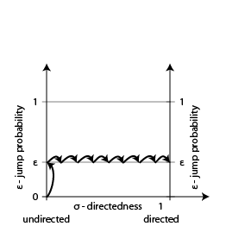
PageRank: Takeaway
1. The stationary distribution is lower-bounded by ε/n.
2. “Small” changes in a walk matrix affect the stationary distribution by little.

Slide 107
How to Compute Random Walks?
(in “a small” number of sequential steps)
L = length
v

Slide 108
How to Compute Random Walks?
(in “a small” number of sequential steps)
L = length
v
v1

Slide 109
How to Compute Random Walks?
(in “a small” number of sequential steps)
L = length
v
v1
v2

Slide 110
How to Compute Random Walks?
(in “a small” number of sequential steps)
L = length
. . .
v
v1
v2
vL

Slide 111
How to Compute Random Walks?
(in “a small” number of sequential steps)
Inherently requires L steps!
L = length
. . .
v
v1
v2
vL

Slide 112
Doubling by Stitching
G
In step i, maintain a number of
2^{i}-length walks from each vertex
w
2^{i}
v

Slide 113
Doubling by Stitching
G
x
In step i, maintain a number of
2^{i}-length walks from each vertex
2^{i}
w
2^{i}
v

Slide 114
Doubling by Stitching
G
x
In step i, maintain a number of
2^{i}-length walks from each vertex
w
2^{i+1}
Merge two walks of length 2^{i}
to obtain one of length 2^{i+1}
v

Slide 115
Doubling by Stitching
But how w knows a priori how many walks will pass through it?
G
x
w
2^{i+1}
v
y

